Slide 1

Data Analytics Bootcamp
Project 1 | Group 4
2021
Notes:
BG
Opening slide

Slide 2

World Happiness
Report
2015 - 2019
Notes:
BG
Introduce the topic

Slide 3
Meet the Team
Alysha Snowden
Alvin Lucero
Bec Gould
Ernest Bondi
Notes:
BG
Introduce Team Members

Slide 4
Contents
Introduction
Hypothesis & Questions
Data Clean-up & Exploration
Data Analysis
Discussion
Post Mortem
Data Sources
Notes:
BG
Provide overview of presentation slides to give audience a high level overview
Just some housekeeping – please post questions in the chat and we will answer them in our Q&A.

Slide 5
Introduction:
As a global society, we are waking up to the fact that happiness in our daily lives is extremely important. The positive effects of a balanced mind spread not only throughout a person's life, but also throughout society in a stone-in-the-pond figure of speech.
Corporations, governments, and organisations are becoming increasingly aware of the importance of happiness. It could be noted that when minimum satisfaction standards are reached people are better able to contribute to their day to day lives and respective duties, and that it is also in their best interests to contribute to people's well-being. As a result, satisfaction metrics are constantly being used in policy decisions all around the globe.
The World Happiness Report is a publication of the Sustainable Development Solutions Network, powered by data from the Gallup World Poll and Lloyd’s Register Foundation, who provided access to the World Risk Poll.
The purpose of this project is to dive in and analyse the happiness score per country around the world and the main characteristics of what forms “Happiness”.
Notes:
BG
Write overview of “happiness” and brief summary of the world happiness report
Detail Data sources used
Elaborate on the questions you asked, describing what kinds of data you needed to answer them, and where you found it
https://www.kaggle.com/mathurinache/world-happiness-report

Slide 6

Questions:
Hypothesis:
Where are the ten Happiest Countries in the world?
H0:Happiness has no relationship with Economy (GDP per capita)
Why are they the Happiest Countries?
Where does Australia rank in the world?
Notes:
BG

Slide 7







Data Sources & Libraries:
https://www.kaggle.com/mathurinache/world-happiness-report
https://geopandas.org/docs/user_guide/mapping.html
Notes:
AL
Elaborate on the questions you asked, describing what kinds of data you needed to answer them, and where you found it

Slide 8

Notes:
AL
Describe the exploration and clean-up process
Discuss insights you had while exploring the data you didn’t anticipate
Discuss any problems that arose after exploring the data, and how you resolved them
Present the discuss interesting figures developed during exploration, ideally with the help of Jupyter Notebook
Notes:
Using a jupyter notebook

Slide 9


Data Clean-up & Exploration:
Using Jupyter notebook we first imported the data sources and read the csv files.
Notes:
AL
Describe the exploration and clean-up process
Discuss insights you had while exploring the data you didn’t anticipate
Discuss any problems that arose after exploring the data, and how you resolved them
Present the discuss interesting figures developed during exploration, ideally with the help of Jupyter Notebook
Notes:
Using Jupyter notebook we first imported the data sources and read the csv files.

Slide 10

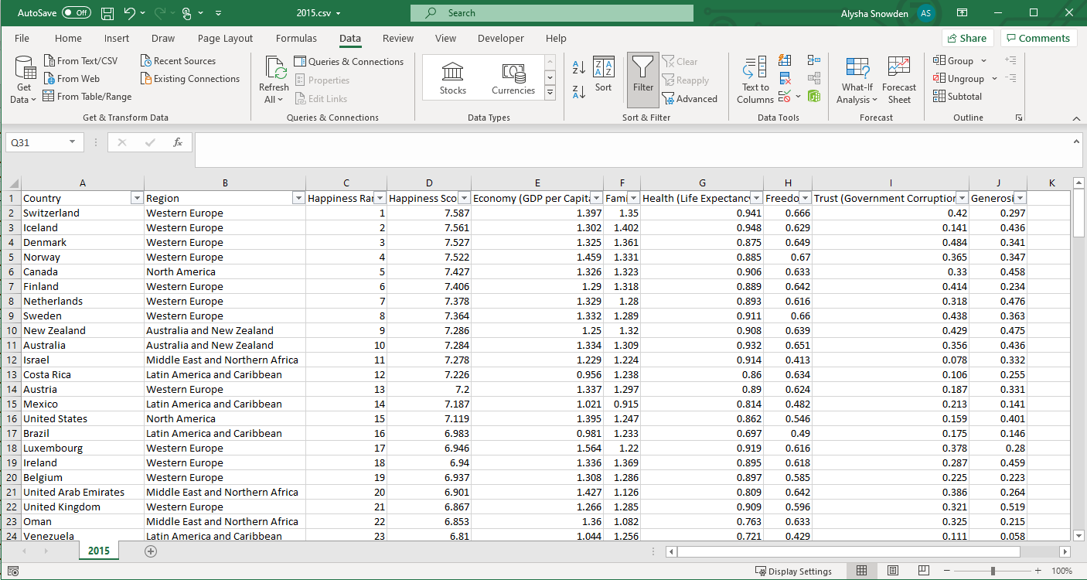
Data Clean-up & Exploration:
Populated the missing region values per CSV data source file using excel VLOOKUP function.
Notes:
AL
Describe the exploration and clean-up process
Discuss insights you had while exploring the data you didn’t anticipate
Discuss any problems that arose after exploring the data, and how you resolved them
Present the discuss interesting figures developed during exploration, ideally with the help of Jupyter Notebook
Notes:
Upon reviewing the CSV file data frames, we identified that that some the CSV files were missing regions. We used VLOOKUP in the csv file to add in the missing region values.

Slide 11
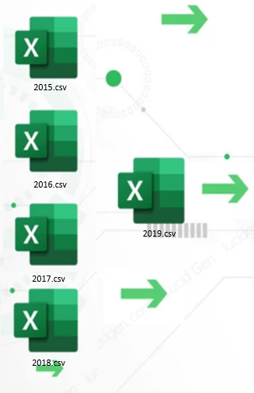
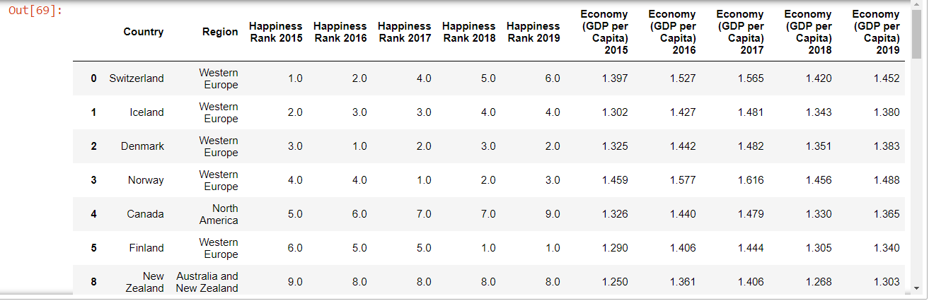
Data Clean-up & Exploration:
Merged CSV files to create one merged data frame.
Notes:
AL
Describe the exploration and clean-up process
Discuss insights you had while exploring the data you didn’t anticipate
Discuss any problems that arose after exploring the data, and how you resolved them
Present the discuss interesting figures developed during exploration, ideally with the help of Jupyter Notebook
Notes:
Dropped countries with missing data
Renamed the column headers to add year suffix
Merged data on Country and Region
Dropped NA (Null) values

Slide 12
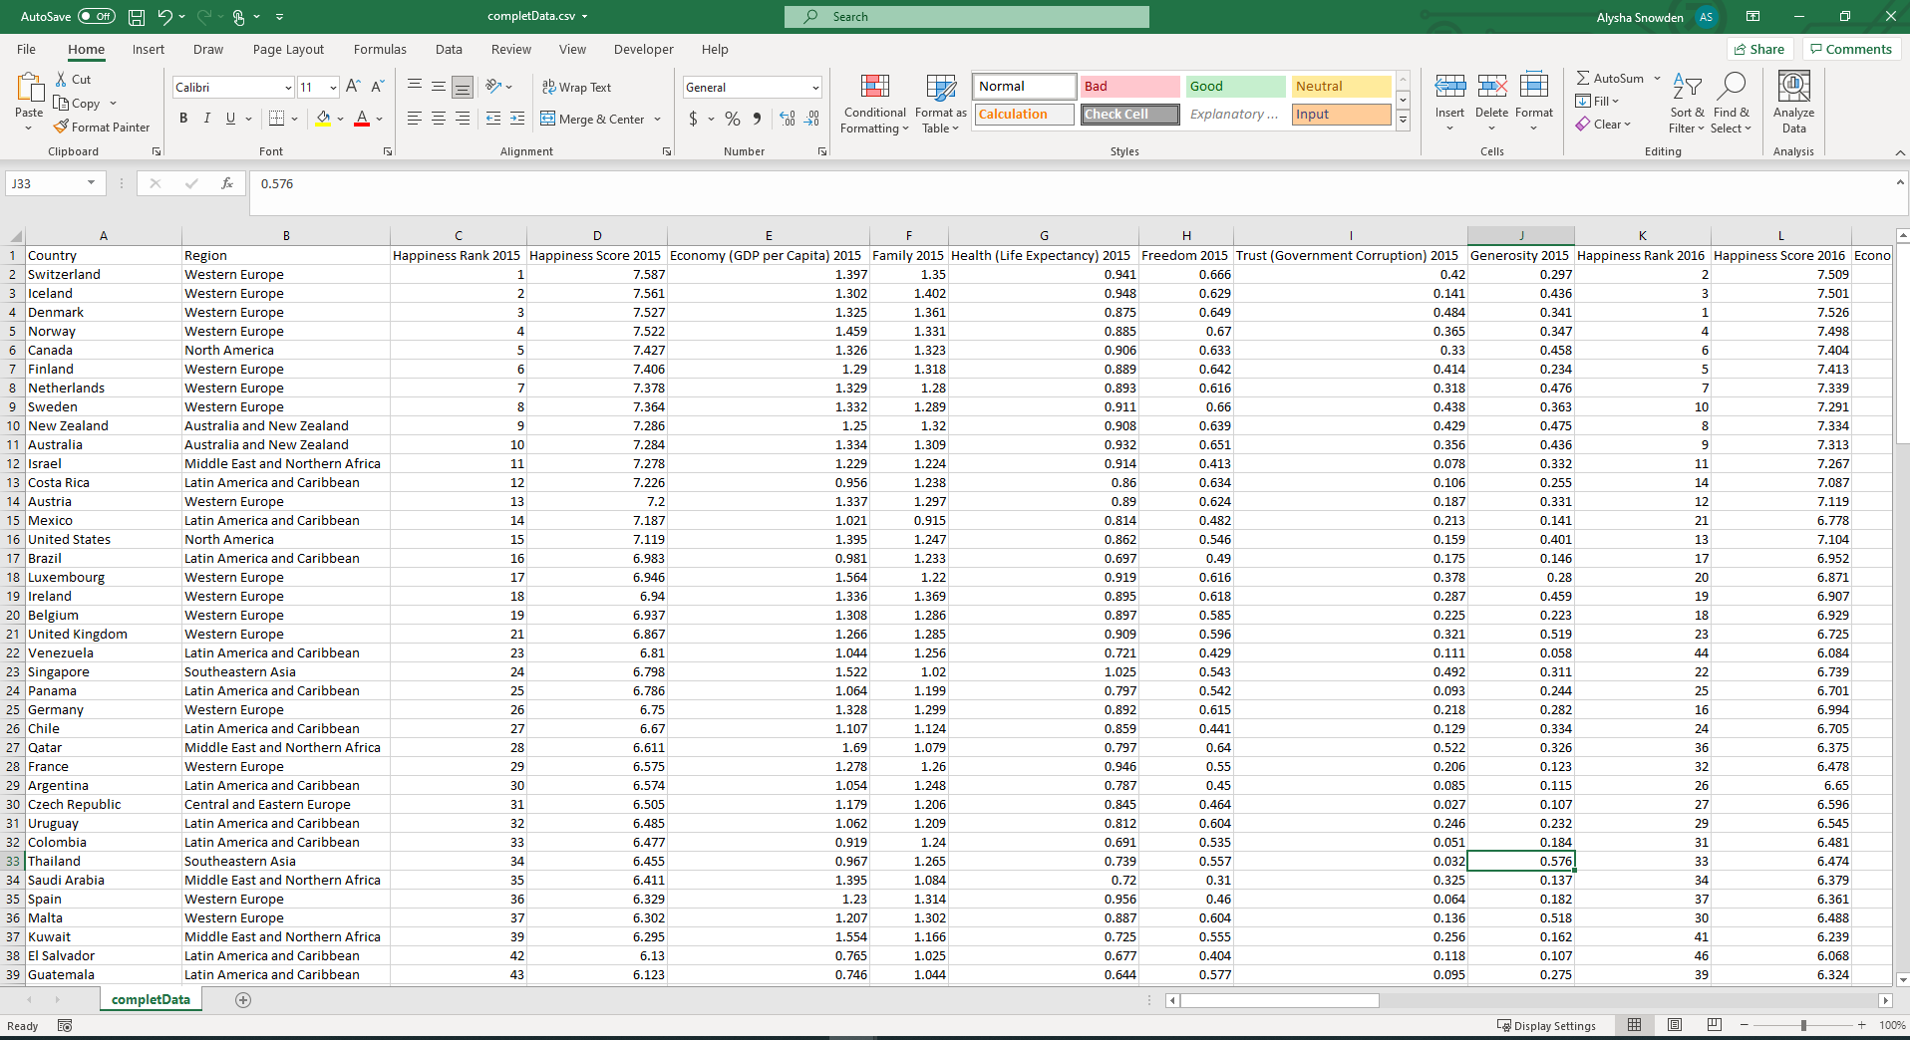

Data Clean-up & Exploration:
Output clean and merged CSV File
Notes:
AL
Describe the exploration and clean-up process
Discuss insights you had while exploring the data you didn’t anticipate
Discuss any problems that arose after exploring the data, and how you resolved them
Present the discuss interesting figures developed during exploration, ideally with the help of Jupyter Notebook
Notes:
Output merged and cleaned csv file for baseline for the analysis

Slide 13
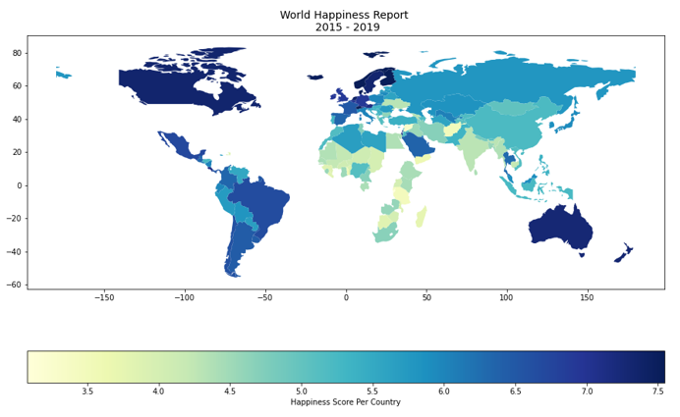
World Map:
Notes:
AS
Geopandas Choropleth Map
To provide an overview of the happiness score per country around the world we are using a geopandas choropleth map to provide a visual.
Geopandas provides a high-level interface to the matplotlib library for making maps and takes pandas's DataFrame to the next level by allowing it to parse geospatial data.
Install required Python libraries
Load and view the shapefile data
Inspect count of the World shape file data
merge both data sets using name/Country as unique identifiers
check the occurrence
plot merged file

Slide 14
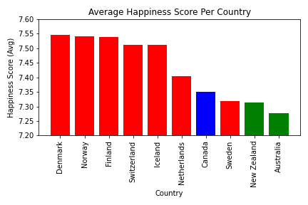
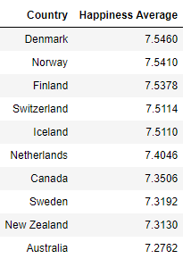
Where are the top 10 happiest countries?
Notes:
AS
From a reset data frame, we have generated a Pyplot bar graph which reflects the highest 10 Happiest Countries in the world based on an Average Happiness Score Per Country.
From the bar graph we can see the top ten happiest Countries are Denmark, Norway, Finland, Switzerland, Iceland, Netherlands, Canada, Sweden, New Zealand and Australia.

Slide 15
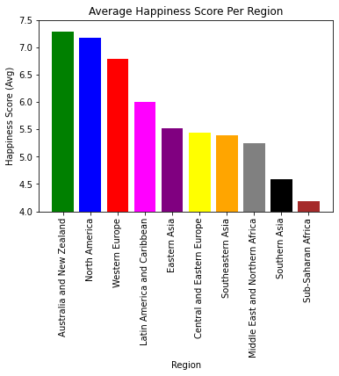
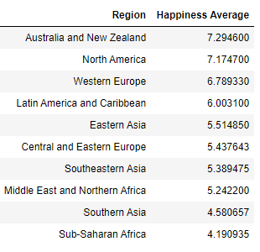
Which region has the highest happiness score?
Notes:
EB

Slide 16
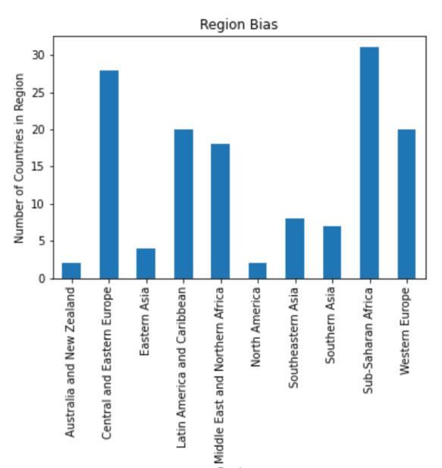
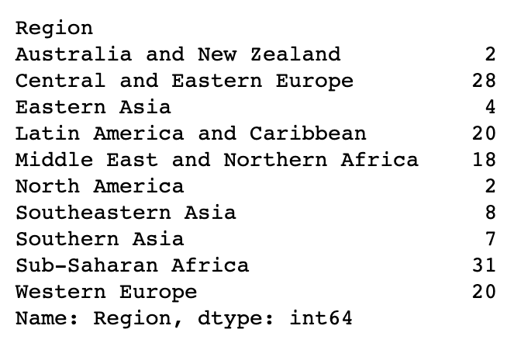
Breakdown of regions
Notes:
EB

Slide 17
What are the variables that are used to measure happiness?
Health (Life Expectancy)
Generosity
Trust (Government Corruption)
Family
Freedom
Economy (GDP per Capita)
Notes:
AS
So, what are the variables that are used to measure happiness?
The World Happiness report and the annual release of the Gallup World Poll (GWP) indicates the following variables are used to measure the national average response to the question of life evaluations.
Characteristics:
Trust (Government Corruption) - The measure is the national average of the survey responses to two questions in the GWP: “Is corruption widespread throughout the government or not” and “Is corruption widespread within businesses or not?”
Generosity – Residual of regressing the national average of responses to the question “Have you donated money to a charity in the past months?”
Health (Life Expectancy) – Average number of years that a newborn can expect to live in full health.
Family – Having friends and other people, including family, turning to in times of need or crisis to give you a broader focus and positive self-image.
Freedom – Freedom of choice describes an individual's opportunity and autonomy to perform an action selected from at lease two available options unconstrained by external parties.
Economy (GDP per Capita) – Measure of a country's economic output that accounts for its number of people.

Slide 18





Average Happiness Score
Notes:
AS
The happiness average score per country is summarized by the overall average of all variables.
If you imagine a ladder, with steps numbered from 0 at the bottom to 10 at the top. The top of the ladder represents the best possible life for you and the bottom of the ladder represents the worst possible life for you. On which step of the ladder would you say you personally feel you stand at this time?”

Slide 19
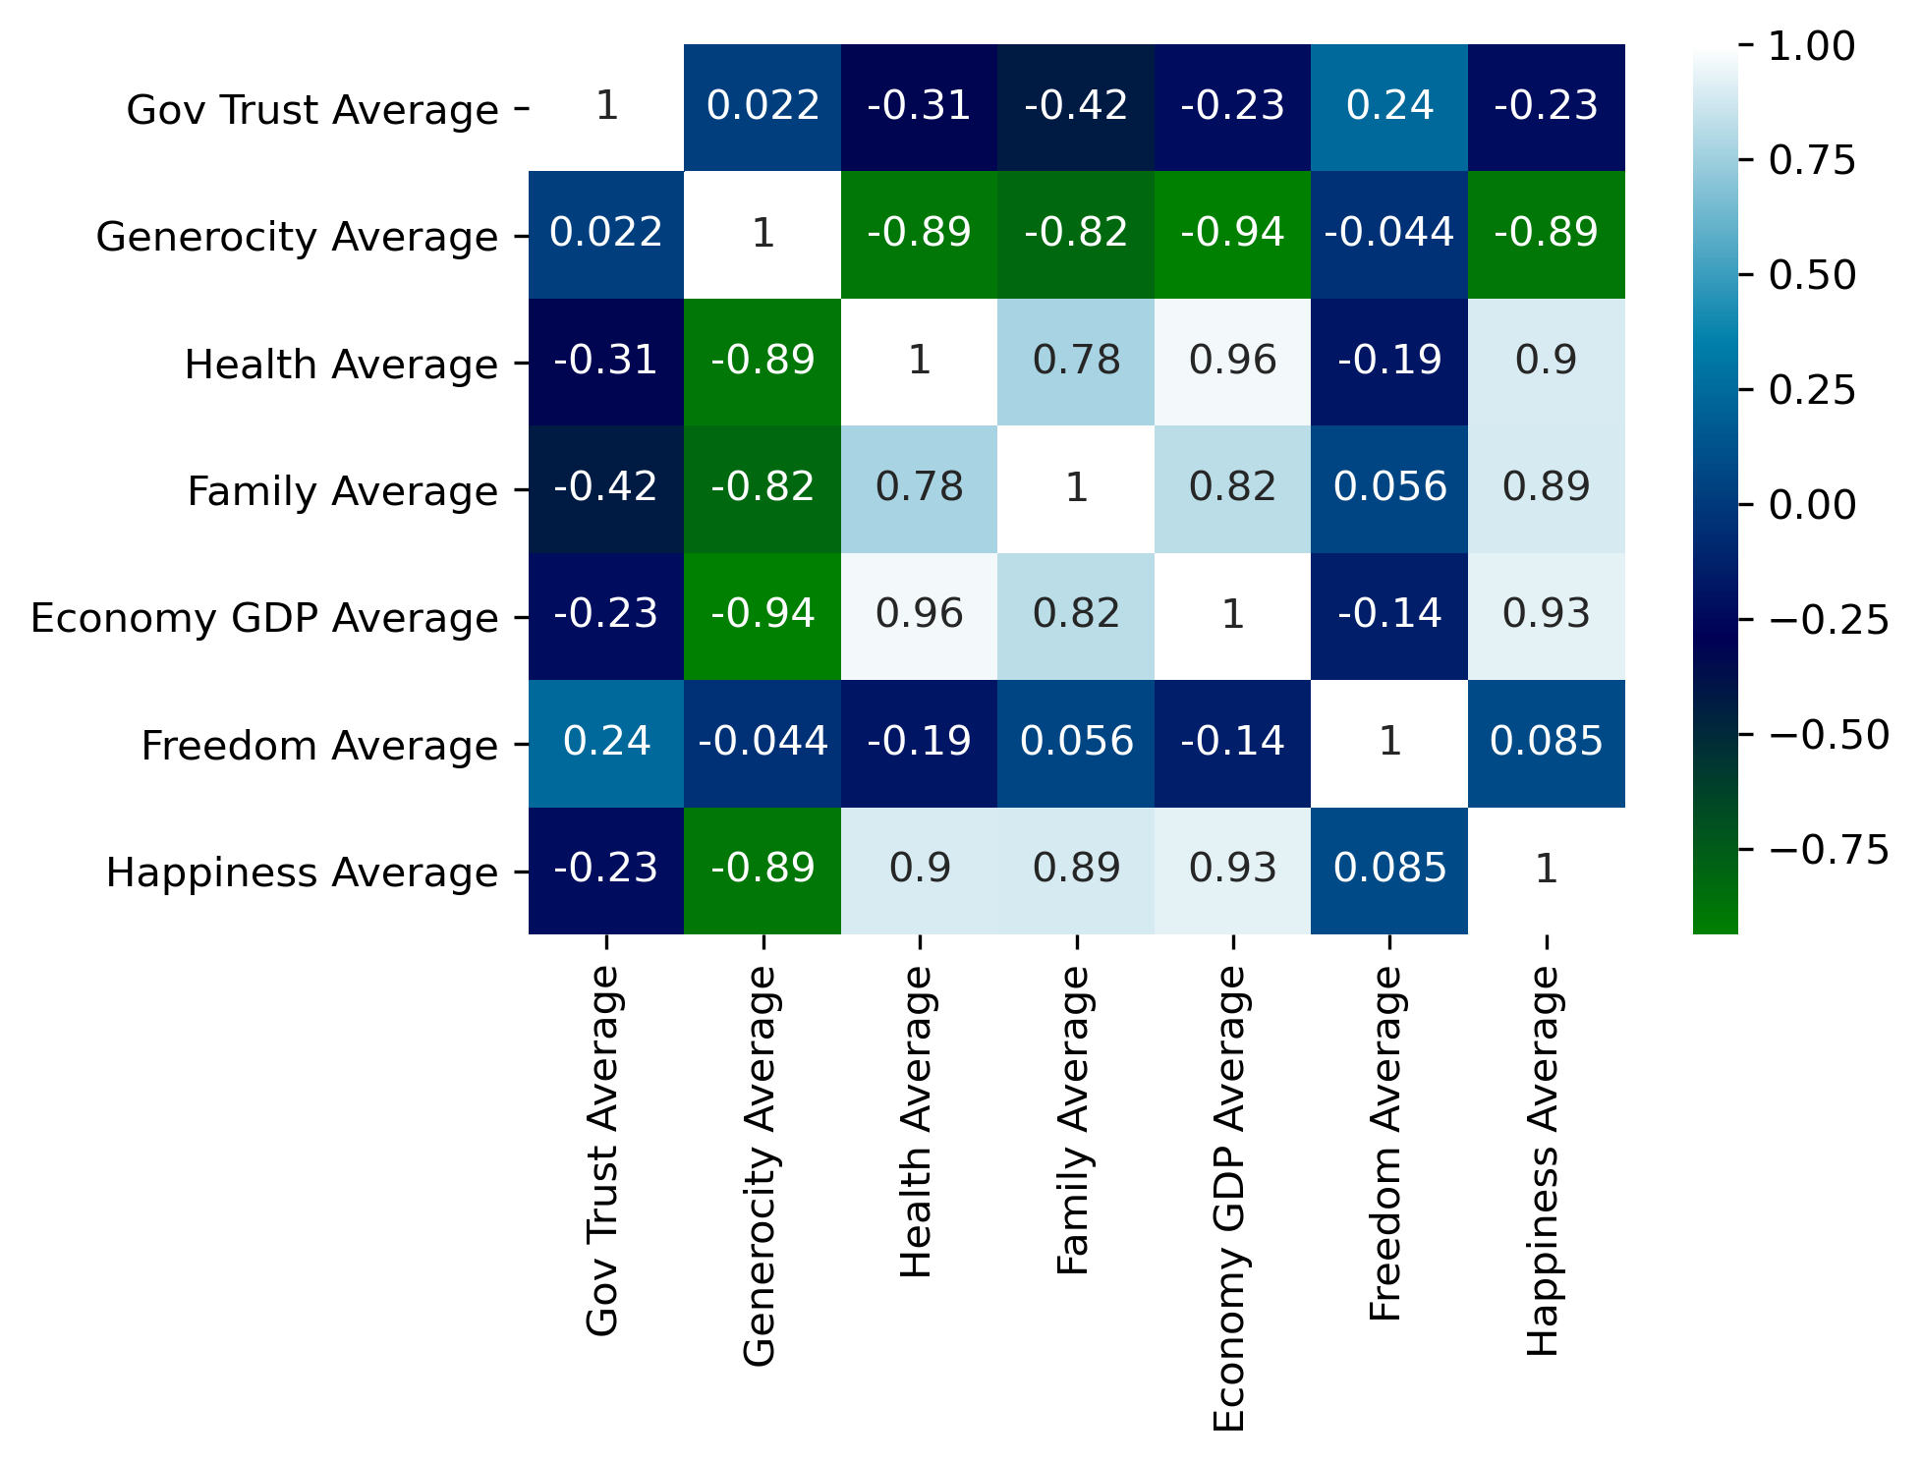
Why are they the happiest countries?
Top variables contributing to happiness
Economy GDP
Health
Family
Notes:
AS
Seaborn Correlation Heatmap
When generating a correlation heatmap using the seaborn library you can easily see the top three variables contributing to happiness are;
Economy GDP
Health
Family

Slide 20
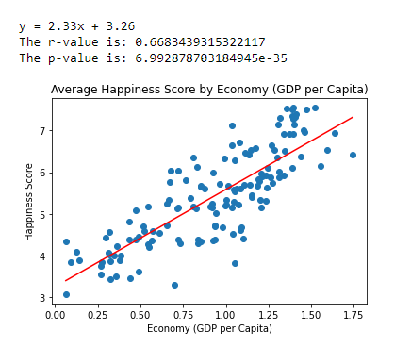
Does Economy (GDP Per Capita) correlate with happiness score?
Notes:
EB

Slide 21
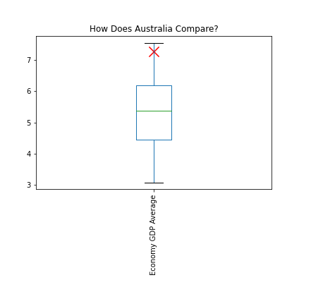
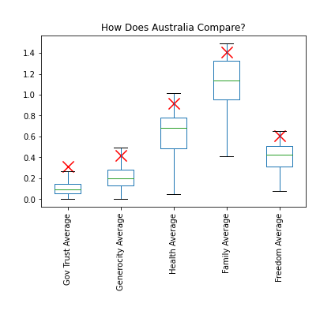
Where does Australia rank in the world?
Notes:
AL

Slide 22
Discussion
Australia is in the top 10 happiest countries.
Australia sits above the mean for each variable.
The happiest region is Australia and New Zealand
7 of the top 10 happiest countries are from one region however, that region only ranked third happiest.
The P value is less than 5% so we reject the null hypothesis and conclude that there is a relationship between Happiness and Economy (GDP per Capita).
Notes:
AL
Discuss your findings. Did you find what you expected to Find? If not, why not? What interferences or general conclusions can you draw from your analysis.

Slide 23
Post Mortem
We originally planned on doing our project on Covid and how it affected the suicide rate, the divorce rate and was there an increase in births. We had issues with trying to find the data and also current data.
We identified a problem with the data when completing the correlation heat map. Our code was calling the incorrect data frame and was resulting in the incorrect figures being generated.
We identified a bias in the data as some regions have multiple countries and others only have two e.g. Australia and New Zealand.
If we had more time we would have cleaned the data more. For example, update the Country names to align the world happiness report data to the geopandas data for to match the Country names. The choropleth map has missing data due to names not matching our data set. E.g. United Sates and United States of America.
Notes:
BG
Discuss any difficulties that arose, and how you dealt with them.
Discuss any additional questions that came up, but which you didn’t have time to answer. What would you research next, if you had two more weeks

Slide 24

Notes:
Open floor Q&A with the audience

